Slide 1
Smart Library Management System
(BiblioTrack)
Project’s Supervisor: Dr. Javed Iqbal
Email: javaidiq@uop.edu.pk
FYP Proposal Defense
.
Project Partners
    Syeda Dilawaiz
    92-B
    Designer
    Haneef Ur Rahman
    189-D
    Developer

Slide 2

Introduction
Traditional libraries play an important role
in academic learning.
They provide access to:
    Physical books
    Reference materials
    Academic resources
However, In modern education Students today rely heavily on:
✔ Online access
✔ Instant information
✔ Smart assistance systems

Slide 3
Problem Statement
The CS department library lacks:
  Proper digital resource management
  Smart search functionality
  No Reservation System
  Instant student assistance
  Automated fine & issue tracking
This creates inefficiency and delays.

Slide 4
Proposed Solution
We developed:
A Web-Based CS Department Digital Library & Management System With Integrated AI Chatbot
The system manages:
Physical Books
Digital Resources (PDFs)
Fine Management & Reservation System
AI Student Assistant

Slide 5
System Modules
1. Admin Module
  Dashboard Overview
  Add / Edit / Delete Books
  Upload Digital Resources (PDFs)
  Manage Students
  Manage New Book
  Requests
  Fine Management
2. Student Module
  Search Physical Books
  Check Availability
  Request New Books
  View Issued Books
  Reservation System
  Clearance Report
  E - Challan System
  Download Digital PDFs
  Use AI Chatbot

Slide 6

Digital Library Module
Our system includes a Digital Library Section where: Admin uploads PDF books.
Students can view, download, and Search digital content.
Organized by Category-Based.
Benefits:
24/7 access
No physical dependency
Supports remote learning

Slide 7
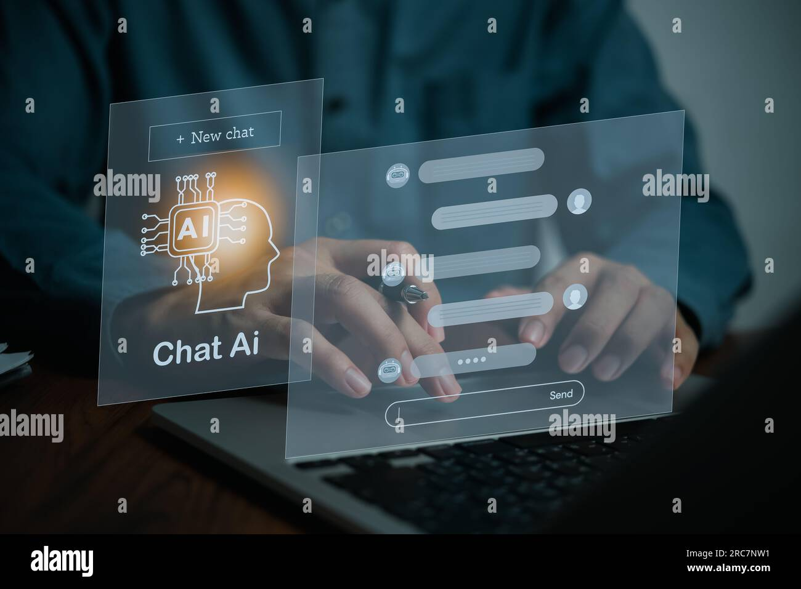
AI Chatbot Integration
The chatbot assists students with:
  Book Recommendation System
  Book availability
  Fine details
  Issued & Reserved books
If question is not related:
“Sorry, I can only answer library-related questions.”

Slide 8
Reservation & Fine Management
Reservation System
  Students can reserve unavailable books.
  Books auto-issue when available.
  First-come, first-served queue
  Students wait until their turn.
  Reservation can be cancelled anytime.
E - Challan System
  Contains student and fine details.
  Overdue fines are auto-calculated.
  Payment via 1-Bill using Challan No.
  Student confirms payment (“I have paid”)
  Admin verifies and clears the fine.

Slide 9
Technologies, Tools & Languages
Frontend: React.js
Styling: Tailwind CSS, Bootstrap, and CSS Media Queries
Backend: Express & Node.js
Database: MongoDB (NoSQL)
Deployment: Local Host, GitHub
Version Control: GitHub
Other Tools: Visual Paradigm (for diagrams), Paper Wireframes, Figma (UI Screens), and NodeMailer (SMTP) — Automated library email notifications

Slide 10
System Architecture
Frontend (Web Interface)
Backend (Core System Logic)
Database (Book & Student Records)
Digital Resource Storage
AI Chatbot Logic

Slide 11
Novelty & Innovation
Hybrid Library System (Physical + Digital)
AI Student Assistant
Department-Specific Design
Real-Time Resource Access
User-Friendly Interface

Slide 12
Project Deliverables
Our project delivers:
Admin Dashboard & Student Portal
Physical Books Management & Digital Library Module
Smart Search System
Fine & Issue System
Reservation System
AI Chatbot Assistant
Fully Functional Web System

Slide 13
Conclusion
  Improves efficiency of CS Department Library
  Provides instant student support
  Combines physical and digital resource management
  Modern, scalable web-based solution

Slide 14

  .

